Slide 1

PROJECT REPORT
S
On
FAKE NEWS DETECTION SYSTEM USING MACHINE LEARNING
By-
Ayush Arun (2001321550012)
Ajay Saini (2001321550002)
Satyendra Kumar Yadav (2001321550045)
Supervisor-
Dr. Shipra Srivastava
Asst. Professor Cse-IoT

Slide 2

PROJECT TITLE
Fake News Detection System Using Machine Learning
MISINFORMATION DETECTION

Slide 3

CONTENTS
ABSTRACT
INTRODUCTION
EXISTING SYSTEM
DISADVANTAGE
PROPOSED SYSTEM
REQUIRED HARDWARE/SOFTWARE
LIBRARY USED
ALGORITHMS USED
METHODS
TEST CASES
CONCLUSION

Slide 4
ABSTRACT
In our presentation, we're talking about how Machine Learning can help to find fake news.
Fake news is a big problem, so we're using machine learning to teach our model to spot it.
We'll explain how model look at the words in news articles to find hints that the news might not be true.
We'll also show different algorithms to to teach our model about fake news, like using LR,DT,GB and RF.
By testing these algorithms, we can see which ones work best.
Finally, we'll discuss what we can do in the future to make these tools even better and to work together with others to stop fake news from spreading.

Slide 5

INTRODUCTION:What is Fake News
1.Fake news is false information that is deliberately spread to deceive people. It's like telling a made-up story and pretending it's true.
2.Nowadays, fake news is a big problem, especially on the internet and social media. It can be about anything – politics, health, celebrities, and more.
3.The tricky thing about fake news is that it often looks real, with convincing headlines and pictures. People might believe it without checking if it's true.
4.This can cause a lot of confusion and harm because people might make decisions based on false information. Imagine if you believed a fake news story about a cure for a disease, and it turned out to be wrong!
5.That's why it's important to learn how to spot fake news and stop it from spreading. By understanding what fake news is and how it works, we can become smarter and more cautious consumers of information.

Slide 6

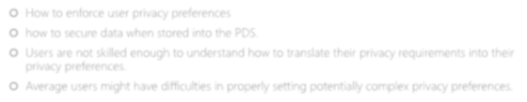
Existing system:
Content Based Approach: Research and analysis of writing style, writer sentiments and pattern ,manually finding fake news.
Fact Checking : For a large news articles ,check each and every paragraph and fact .
Average users might have difficulties in properly differentiating news articles.
Social context Based Approach: To evaluate news authencity on social media, we have to find social cues like interaction between users, source credibility and pattern sharing.
Other model: Model used mostly 2-3 algorithms and trained less number of dataset, so its accuracy is low.

Slide 7

Disadvantages of existing system
1.To distinguish between Fake and True news by viewing manually is very difficult task and have more chances of error. Very less , labelled data for training has been used ,so it will hinder to find out fake news.
2.Environment: Dynamic social context comes to change fastly , so it is very difficult to maintain model accuracy.
3.Model Normalization: Model should be work in all languages and various domain. The people may manipulate feature of news to deceive our model.
4. Deep resourcing: We need to check fact of news manually using expert and skilled person. In a big news , we can not check each and every paragraph manually.
5.Content gathered from different sources can be very difficult for our model to distinguish between news ,so we need to keep balance between precision and recall.

Slide 8

PROPOSED SYSTEM
1.Data collection
2.Removal of special characters.
3.Remove important features from text
4.Divide 75% data for training and 25% for testing
5.Select the model and analyse their precising ,recall, accuracy and f1 score etc.
6.Use pooling method to improve the performance of models
7. Analyze the importance of each model to determine which features have the biggest impact on the forecast.

Slide 9
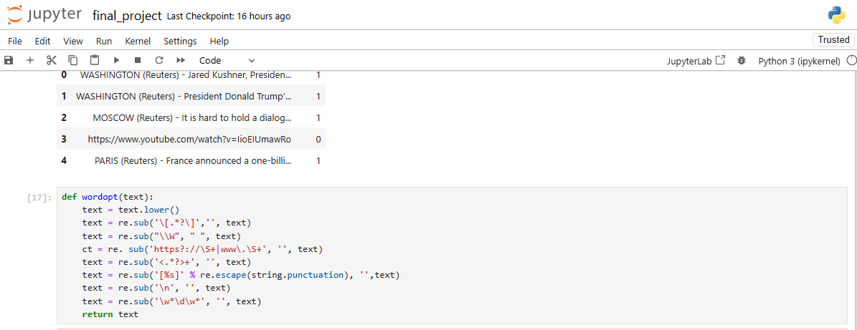

Slide 10

REQUIRED HARDWARE AND SOFTWARE
Processor : 1 gigahertz (GHz) or faster processor or SoC.
RAM: 1 gigabyte (GB) for 32-bit or 2 GB for 64-bit.
Hard disk space: 16 GB for 32-bit OS or 20 GB for 64-bit OS.
Used Jupyter Notebook

Slide 11
LIBRARIES USED
NumPy: NumPy, which stands for Numerical Python, is a library consisting of multidimensional array objects and a collection of routines for processing those arrays.
Pandas: Pandas is an open-source, BSD-licensed Python library providing high-performance, easy-to-use data structures and data analysis tools for the Python programming language.
Matplotlib: Matplotlib is one of the most popular Python packages used for data visualization.
Seaborn: Seaborn is a library mostly used for statistical plotting in Python.
Sklearn: Scikit-learn (Sklearn) is the most useful and robust library for machine learning in Python. It provides a selection of efficient tools for machine learning and statistical modeling including classification, regression, clustering and dimensionality reduction via a consistence interface in Python.

Slide 12


Slide 13
ALGORITHM USED
Logistics regression (logistic regression provides a probabilistic framework for making decisions.)
Decision tree (creating a tree-like structure where each node represents a decision based on a specific feature.)
Random forest (Random Forests serve as a robust and versatile solution in fake news detection
Gradient boosting (Its ability to handle intricate relationships within the data positions Gradient Boosting as a valuable asset in the ongoing efforts to combat the spread of misinformation.

Slide 14
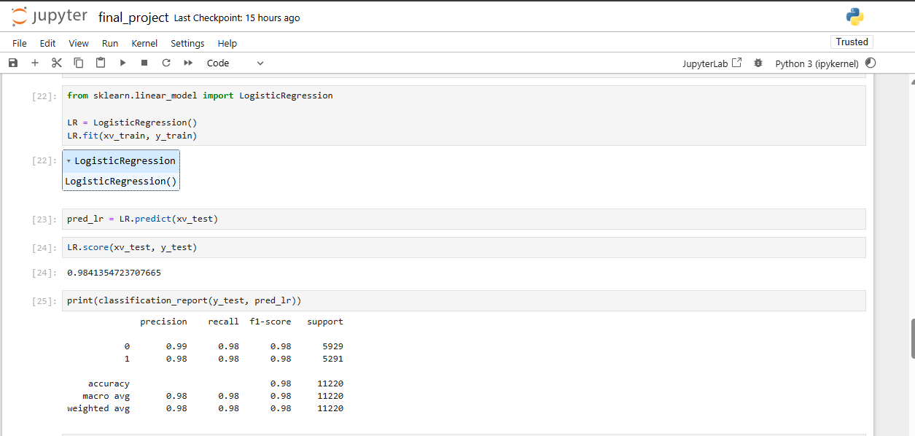

Slide 15
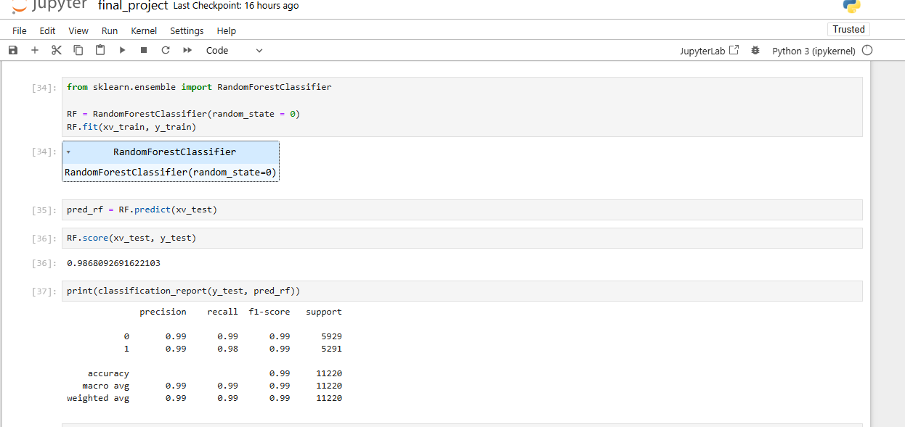

Slide 16
METHODS
To implement this project we are using ‘News’ dataset we can detect whether this news are fake or real.
This dataset I kept inside dataset folder.
Upload this dataset when you are running application.
To run this project deploy ‘FakeNews’ folder on jupiter and then start ser ver.
After running code in web browser will get below page.

Slide 17
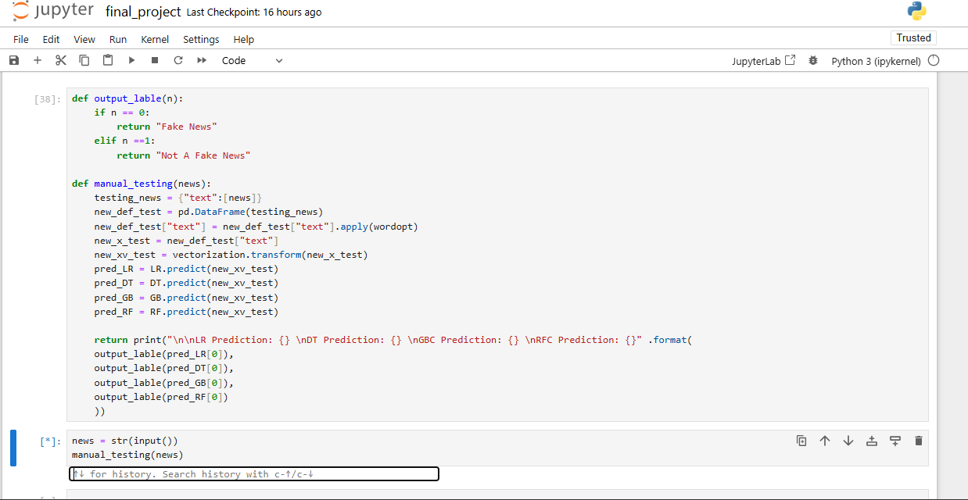

Slide 18
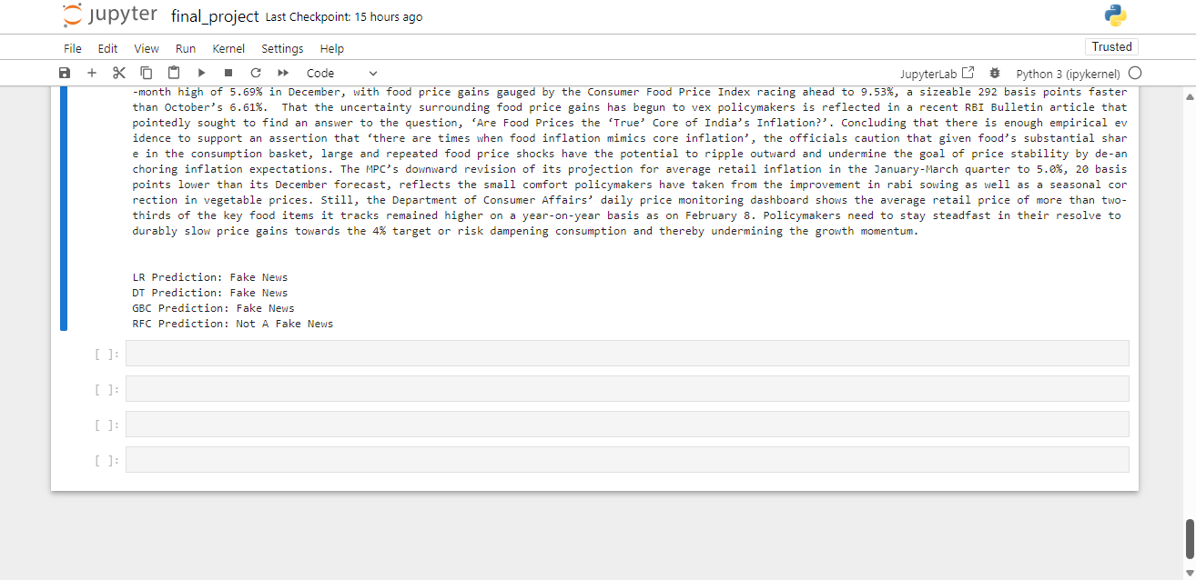

Slide 19
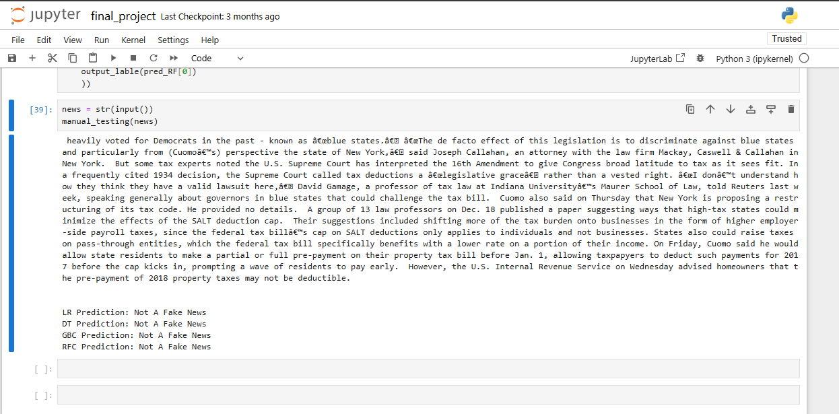

Slide 20
TEST CASES
 | Logistic regression | Decision Tree | Gradient Boosting | Random Forest | Result
NEWS 1 | FAKE NEWS | NOT A FAKE NEWS | NOT A FAKE NEWS | NOT A FAKE NEWS | True News
NEWS 2 | FAKE NEWS | NOT A FAKE NEWS | FAKE NEWS | FAKE NEWS | Fake News
NEWS 3 | NOT A FAKE NEWS | FAKE NEWS | FAKE NEWS | FAKE NEWS | Fake News
NEWS 4 | NOT A FAKE NEWS | NOT A FAKE NEWS | FAKE NEWS | NOT A FAKE NEWS | True News

Slide 21

CONCLUSION
Machine learning is a valuable tool in the fight against fake news. However, it's not a standalone solution. Collaborative efforts and public awareness are essential.
By refining algorithms and educating individuals, we can create a more discerning online community, reducing the influence of misinformation.
Together, we can foster a digital environment where accurate information thrives, empowering people to make informed decisions and uphold the integrity of online discourse.
Looking ahead, there is still much to be done in refining and improving machine learning algorithms for fake news detection.
By staying vigilant and proactive, we can work towards a future where misinformation holds less power, and accurate information prevails.

Slide 22
THANK YOU

